Slide 1
Fundamentals and Link Layer –Unit 1
Network Architecture
S.V.Jansi Rani
Assistant Professor / CSE

Slide 2
Network Architecture
Layering
Provides abstraction – hides complexity of the network from application writers
Build network into more manageable components
Modular design – new service – modify only one layer
Multiple abstractions provided at any level

Slide 3
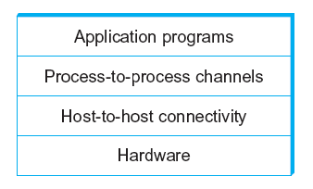
Network Architecture
Example of a layered network system

Slide 4
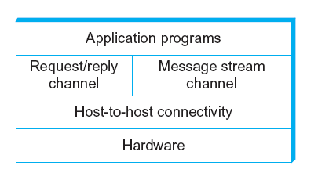
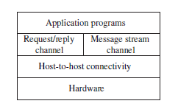
Network Architecture
Layered system with alternative abstractions available at a given layer

Slide 5
Protocols
Protocol defines the interfaces between the layers in the same system and with the layers of peer system
Protocol
service interface – application → http , web browser
Peer interface - meaning of the message exchanged eg-GET
Protocol defines a communicaiton service that it exports locally (the service interface) along with a set of rules governing the messages that the protocol exchanges with its peers to implement the service (the peer service).

Slide 6
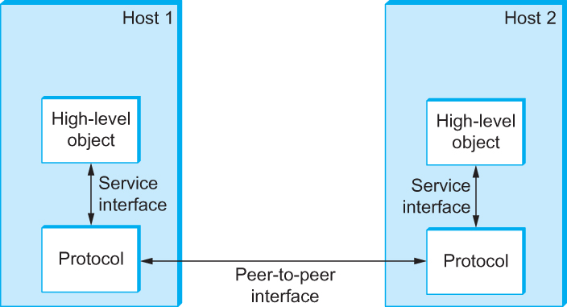
Interfaces
Service and Peer Interfaces

Slide 7
Protocols
Protocol Specification: prose, pseudo-code, state transition diagram
Interoperable: when two or more protocols that implement the specification accurately
IETF: Internet Engineering Task Force

Slide 8
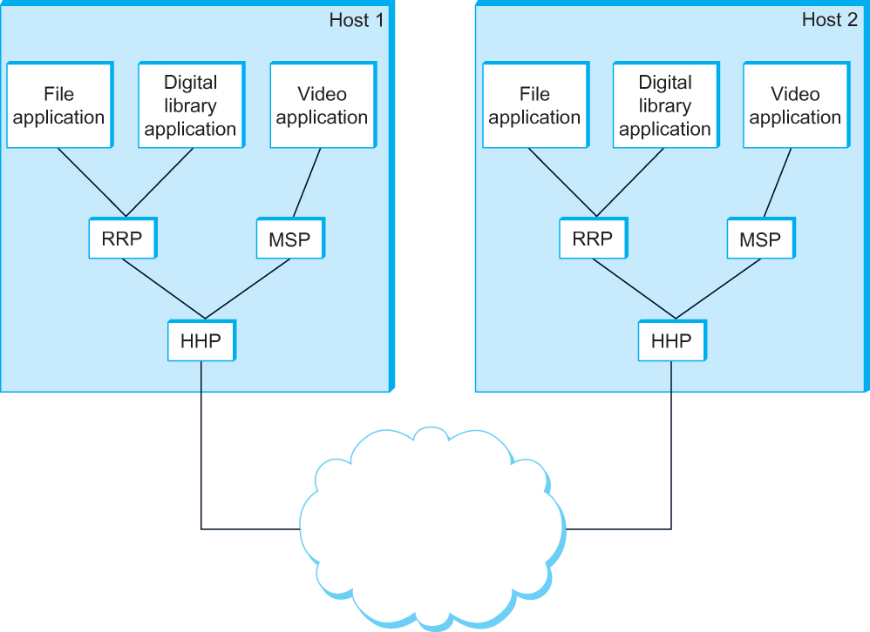
Protocol Graph
Example of a protocol graph
nodes are the protocols and links the “depends-on” relation

Slide 9
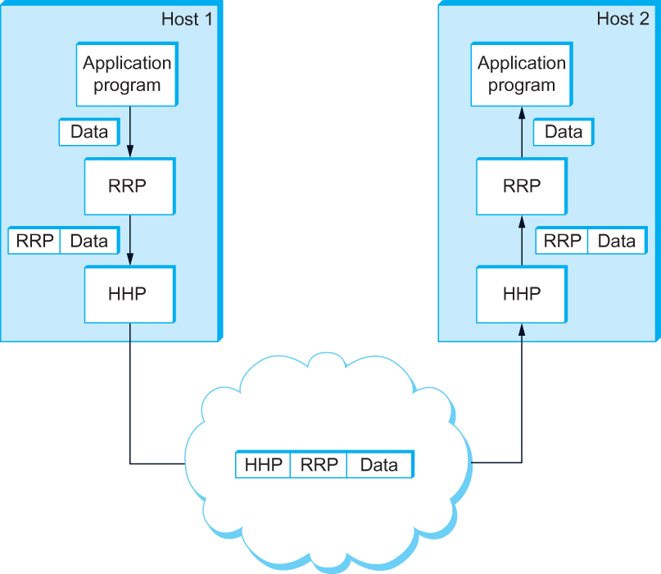
Encapsulation
High-level messages are encapsulated inside of low-level messages

Slide 10
THANK YOU

